Slide 1
Test Automation - Introduction
Software Testing is an essential part of software development life cycle
It reduces time to deliver the software product maintaining the highest standards of quality.
Automation helps by speeding up the testing process and increasing the test coverage.
Automation uses tools, strategies and artifacts that reduces the need of human intervention.
Develops and execute test scripts, compare the actual and expected results and log test execution status.

Slide 2
Test Automation - Introduction
Test Automation tries to increase test coverage
Helps clients to run their business unimpacted and unharmed with no business losses because of continuous changes in business application.
Tools – Quick Test Pro(QTP), Rational Functional Tester(RFT), Rational Robot, Selenium, Silk Test, Test Complete etc.,

Slide 3
Test Automation - Objectives
Better: Automated testing is more reliable than manual testing as tasks performed by manual testers are prone to human error. Test coverage can be improved using automation testing.
Faster : Test execution speed of automation tools is higher than that of manual testers.
Cheaper: Test Automation helps in testing large area of business application in minimum time that otherwise will require large number of manual testers, thereby increasing the testing cost.

Slide 4
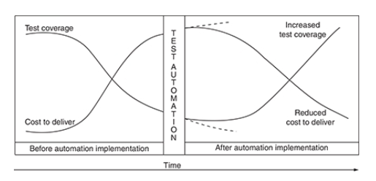
Test coverage: Before and after test automation implementation

Slide 5
Test Automation – Key Factors
Committed management
Budgeted cost
Process
Dedicated resources
Realistic expectations

Slide 6
Committed management
Management need to see test automation as necessary and critical
Project plans and test plans are to be designed based on automation
Management and automation team should be completely committed
Test automation priority is to be assigned and targets need to be set.

Slide 7
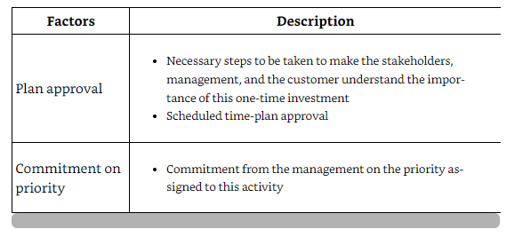

Slide 8
Budgeted Process
Project budget estimates are to be planned based on test automation.
Project budget sheet includes
Automation tool cost
Hardware and software cost
Resource cost
Training cost
Test Automation and implementation cost
Maintenance cost

Slide 9
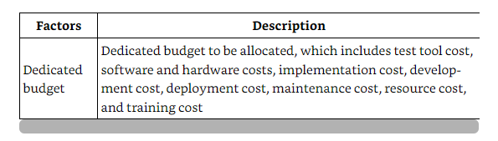
Budgeted Process

Slide 10
Process
Standardized process is one of key to successful execution of an automation project.
Processes are to be defined for each stage of test automation life cycle.
Quality control procedures are to be defined to check and control the quality of test automation project and its deliverables.
Test automation metrics are to be defined to measure the quality, effectiveness and profitability of the automation project.

Slide 11
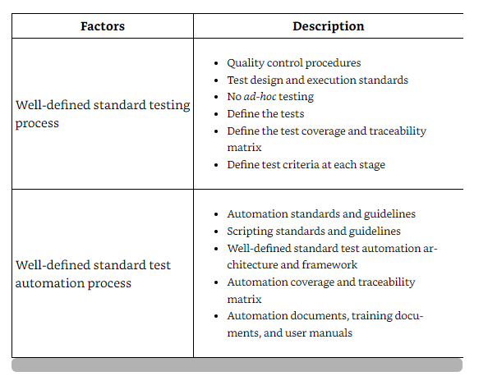
Process

Slide 12
Dedicated Resources
Skilled automation resources are to be allocated to test automation team
Use of manual testers as automation developers is to be avoided.
Automation consultants are to be used to do automation project effort and cost estimation.
Automation architects are to be assigned the task of feasibility analysis and framework design.
Automation developers are to be used for test script development.

Slide 13
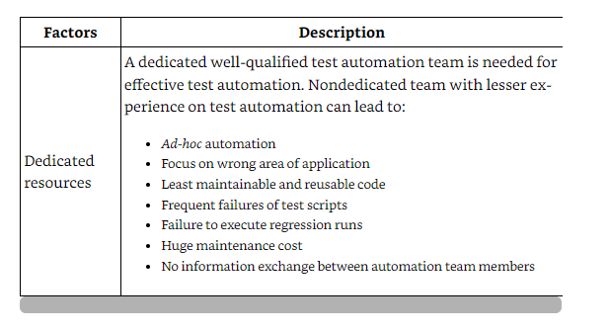
Dedicated Resources

Slide 14
Realistic Expectations
Management and test automation project team should have realistic achievable expectations
Map table has to be created which maps management and testing expectations to the automation deliverables.
Expectations that can not be met need to be filtered at this stage.

Slide 15
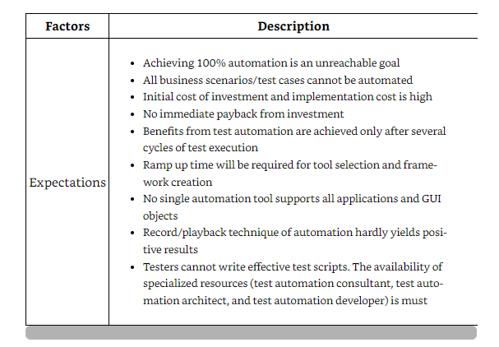
Realistic Expectations

Slide 16
What to Automate
Business context analysis –
Analysis to identify business scenarios that are available and complete.
It implies business scenarios on which change request is not expected.
Prioritization analysis –
Analysis to define priority of automation of the identified business scenarios.

Slide 17
What to Automate
Facilitation analysis –
Analysis to identify business scenarios whose all test cases have been written and test case review is done.
If any gap is found, gap analysis is done to identify gaps.
If the gap can be closed, then it is evaluated for gap closure.
Business scenarios that are found incomplete or non automatable are ignored for automation.

Slide 18
What to Automate
Business Critical analysis –
Analysis of business scenarios as per their exposure to business criticality
Completeness analysis-
Completeness analysis is done to identify business scenarios that are ready for automation.

Slide 19
Automatability analysis-
Analysis to identify business scenarios/test cases that can be automated.
If complete automation is not feasible, attempt should be made to partially automate.
Few parameters on which decision to automate a test case
Business criticality: Test scenarios critical to business. Ex: once failure result in huge monetary loss
Repeatability:Test scenario that need to be executed again and again. Regression test scenarios

Slide 20
Reuability : Test scenario that needs to be executed over a wide range of input data variations. Ex: testing the login screen with different set of input data.
Robust: Test scenarios that are prone to human errors. Ex: comparing data of two excel files.
Execution time: Test scenarios that are time consuming. Ex: transferring funds from the same account more than 100 times.

Slide 21
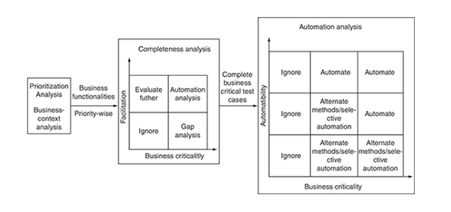
Identifying business scenarios for automation

Slide 22
W
What not to Automate
Parameters based on the decision to reject a scenario for automation:
Negative return on investment (ROI): Test scenarios whose automated ROI is negative as compared to manual testing. Ex: Test scenarios that are executed once in a while.
No baseline: Test scenarios for which accurate input data or expected output is not known. Ex: format of PDF reports.

Slide 23
GUI testing: Test scenarios that test the look, feel, color etc., of GUI.
Baseline complexity: Complex test scenarios that involve multiple steps unrelated to each other. Ex: GUI test scenarios that interact with disintegrated independent system.
Automation complexity: Test scenarios that involve GUI objects that cannot be recognized by the automation tool and output cannot be retrieved accurately.

Slide 24
BENEFITS OF TEST AUTOMATION
Reliable: Tests perform the same operations each time they are executed, thereby eliminating human error.
Reusable: Same tests could be used to test on different environment settings.
Repeatable: Same tests could be executed repeatedly
Fast : Test automation tools execute tests at much faster pace than that of human users

Slide 25
Comprehensive: Test suit can be made that tests every feature.
Cost reduction : Tests can run in unattended mode 24/7 thereby reducing the human effort and cost.
Programmable: Complex business scenarios can be automated to pull out the hidden information.

Slide 26
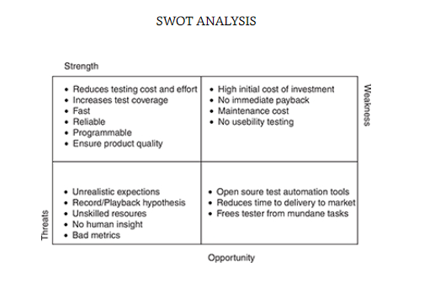
SWOT ANALYSIS

